Slide 1
Analyzing Reader’s Visual Attention On Controversial News Articles
By Ahmad hilman bin sabri

Slide 2
objective
1. To measure the correlation of a reader's visual attention to:
Layout of content. (text, images, quotations)
Type of content (article, tweets, user comments).
Writing style. (passive, aggressive)
Distractors (advertisements, recommendations).
2. To analyze confirmation bias in terms of types of content:
Certain people respond more to Tweets rather than article, vice versa
This can be observed during post-survey, where they will be asked questions, in which they have to recall information they have learned from either the article, Tweets, or user comments.
3. To calculate the correlation of a reader's visual attention and confirmation bias using statistical analysis (PCA,ANOVA)
Notes:
The objective of this research is to study :
The correlation of a reader's visual attention to:
Layout of content. (text, images, quotations)
Type of content (article, tweets, user comments).
Writing style. (passive, aggressive)
Distractors (advertisements, recommendations). ***measurement is how much visual attention to each type of media***
2. The confirmation bias on types of content –
***certain users respond more to article than tweets etc***
***measurement is if information from respective media is recalled during post-survey***

Slide 3
Research question & hypotheses (1)
RQ : Does an article’s writing style affect readers? H : Passive writing and aggressive writing will influence the readers differently
RQ : Do captioned pictures garner more visual attention than uncaptioned pictures? H : Captioned pictures will garner more visual attention as it gives more context to the reader.
RQ : How does information presentation affect readers' visual attention? H : Information presented in different methods will receive different visual attention from readers.

Slide 4
Research question & hypotheses (2)
RQ : Are Tweets better at conveying information compared to traditional articles? H : Tweets conveys information easier to readers, as they are more direct and informal.
RQ : Are Tweets, User Comments and the article itself given the same level of attention by readers? H : Based on literature review, we expect only 40% of readers are going to read the user comments. Hence, all three types of information will be treated differently by the readers.

Slide 5
Problem statement
In this digital era, information is rapidly spread to the public almost instantaneously. Everyone has access to the news and everyone can choose their sources.
This shift has changed how news is presented and delivered. One of the new additions is Tweets, which are social postings from Twitter. Over the years, more and more news site have incorporated Tweets into their article, mainly as to show the public’s reaction to the situation.
Moreover, readers are now able to leave their comments and thoughts in the User Comment section. This in turn, forms a free-for-all discussion forum, which could greatly influence the readers positively or negatively. This allows us to test the theories of confirmation bias and information presentation.

Slide 6
Literature review (1)
Steinfeld, N., Samuel-azran, T., & Lev-on, A. User Comments And Public Opinion: Findings From An Eye-tracking Experiment
Objective : To study how many people actually read user comment and not just self-reported they did, by using an eye-tracker.
METHOD : This study examines participants' ocular behavior in response to different online articles, and its correlation with evaluations of the articles.
FINDINGS : 40% of participants read the comments, and spent more time on it compared to the article. This confirms that user comments significantly extend the time readers remain on online newspapers' website. Follow-up interviews show that participants believed user comments to be commercialized and biased. The findings strengthen the confirmation bias and active audience theories, which argue that people interpret information in line with their preexisting beliefs.

Slide 7
Literature review (2)
Raffael Heiss, Christian Von Sikorski & Jörg Matthes Populist Twitter Posts In News Stories
Objective : To prove that highlighting posts in news article increases statement recognition, and will have stronger effects among leftist and rightist compared to centrist.
METHOD : An online experiment is designed with five groups. They’re then exposed to two news articles, each including populist statement of well-known politician from the right-wing populist who represents a large share of conservative voters. All groups saw the same statements, but the appearance of the statements is manipulated.
FINDINGS : Visually exposed cross-cutting political views may indeed increase disconfirmation bias in individuals. Journalists are increasingly using politicians’ Twitter posts as easily accessible and eye-catching information sources in an increasingly competitive online environment.

Slide 8
Methodology
Define Study and Research
Gather participants
Perform Experiment
Design Experiment
Collect and Analyze Data

Slide 9
Methodology – sample size
Sample Size:
A sample size of 60 students is used for the experiment
The sample size will then be split into three groups, based on their stance towards the article (for, against, indifferent)
Each group total results will be reduced to roughly the same distribution (1:1:1 distribution) to ensure diversity and balance.

Slide 10
Methodology - flowchart
Introduction
Practice Trial
Pre Survey
Experiment Article A
Distractor
Experiment Article B
Post Survey 1
Post Survey 2

Slide 11
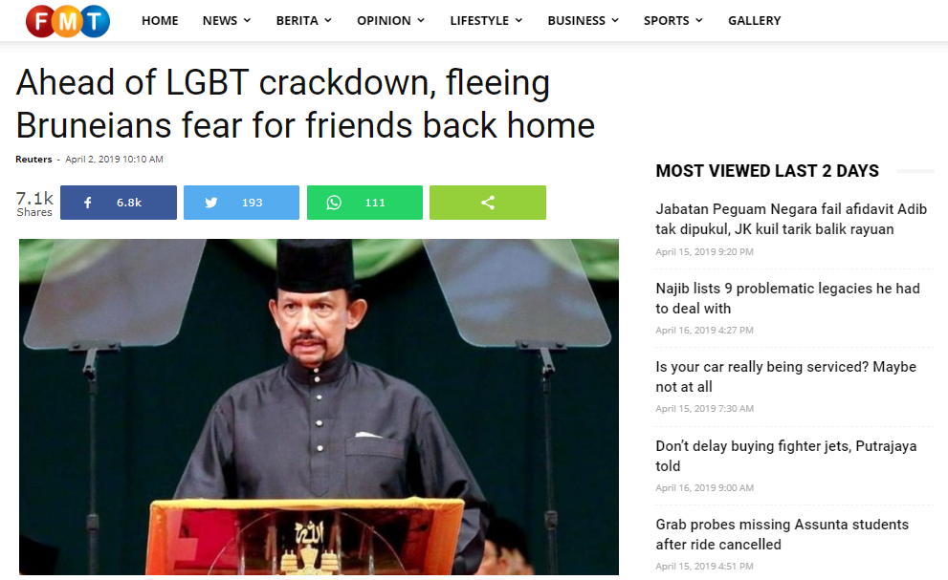
Bruneians overseas worry for locals back home following LGBT crackdown

Slide 12
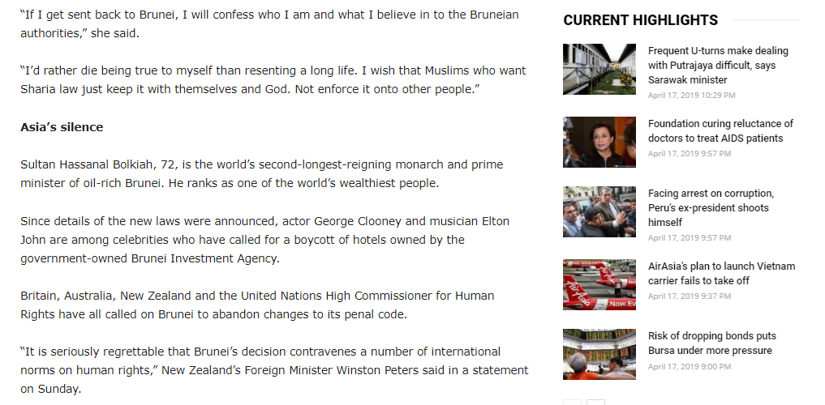
Distractors

Slide 13
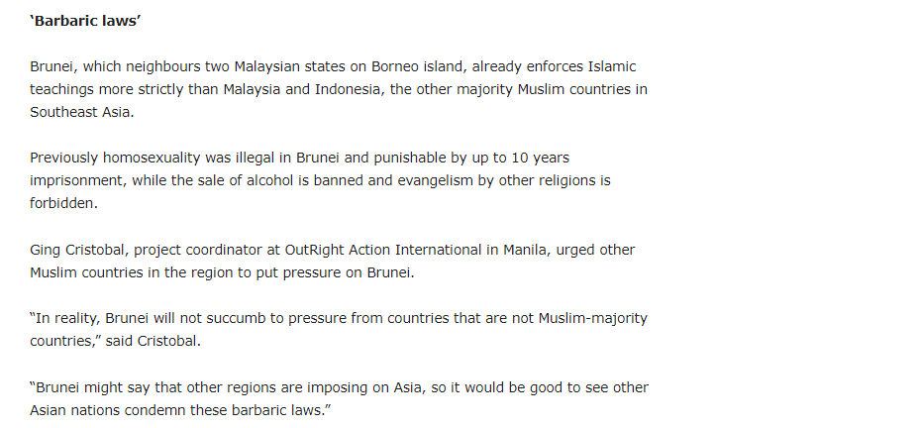
Highlights
Previously homosexuality was illegal in Brunei and punishable by up to 10 years imprisonment, while the sale of alcohol is banned and evangelism by other religions is forbidden.

Slide 14
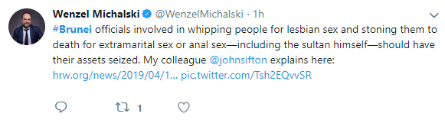
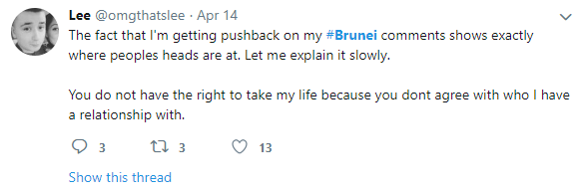
Many people on Twitter have expressed outrage and disgust over the matter.
Tweets

Slide 15
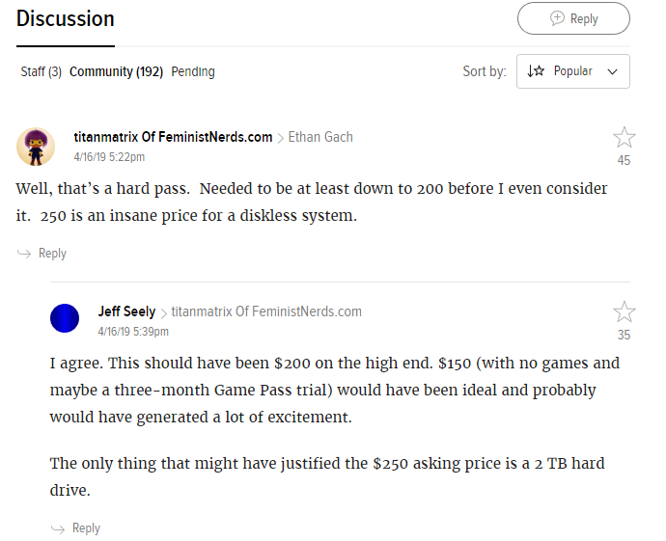
User Comments
With due respect, the law applies only to Muslims. Whatever they so in closed doors is between them and Allah, but when they encroach on the collective rights of the public, such is when punishment is due
In the US, we are battling those who are exceptionally Anti-Islam (islamophobic). THEY feel it should not be be accepted by the public. They would be happy to see those who are Islamic 'stoned to death'. Do you think they should have the right as well to do so?

Slide 16
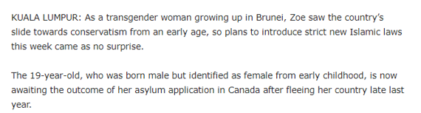
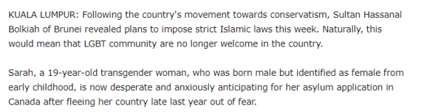
Passive Writing Style
Aggressive Writing Style

Slide 17
requirements
Stimulus relevant to current times and participants.
Stimulus is clear and not complex.
Each sub-stimulus (article, tweets, user comments) deliver their respective information without conflicting each other.
Article A and Article B needs to talk on the same topic, but not immediately distinguishable as the same article.
Participant sample size needs to be diverse and balanced.
Participants need to be clear on instructions and procedure to avoid bad data.

Slide 18
Analysis and design
PRE-PROCESSING - Eye-tracking Metrics - number of fixations on each area-of-interest - fixation duration - time to first fixation on target - repeat fixation (revisits) - Repeated Measures (2 trials for each participant)
Notes:
number of fixations on each AOI
total number of fixations, fixation duration
total fixation duration
time to first fixation on target
fixation density
repeat fixation

Slide 19
Analysis and design
POST-PROCESSING - ANOVA Between and Within Groups - Principal Component Analysis (PCA) - a technique used to emphasize variation and bring out strong patterns in a dataset. It's often used to make data easy to explore and visualize. - PCA is a dimensionality-reduction method that is often used to reduce the dimensionality of large data sets, by transforming a large set of variables into a smaller one that still contains most of the information in the large set.

Slide 20
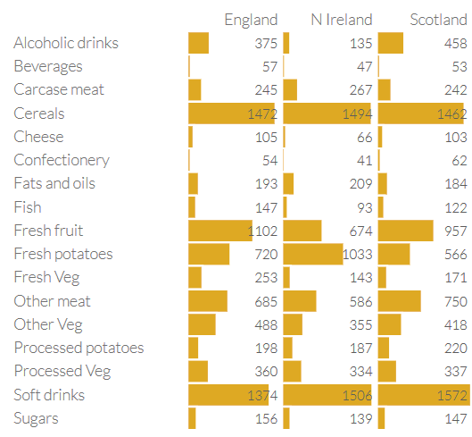
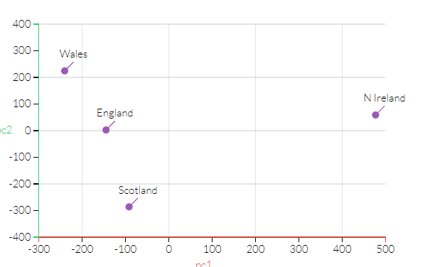
PCA

Slide 21
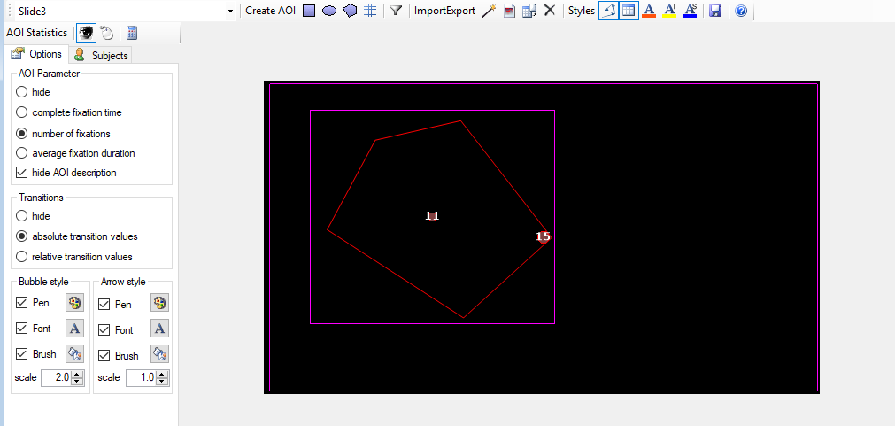
Analysis and design

Slide 22
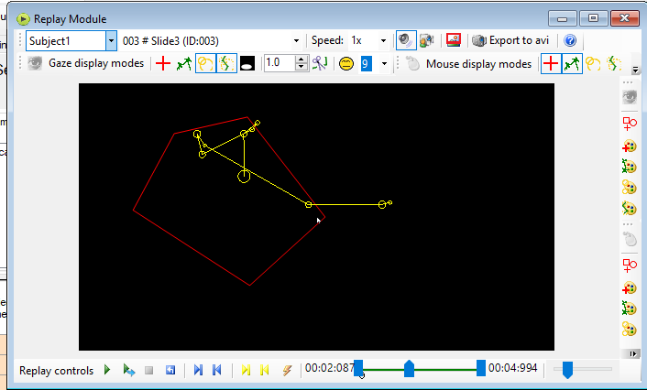
Analysis and design

Slide 23
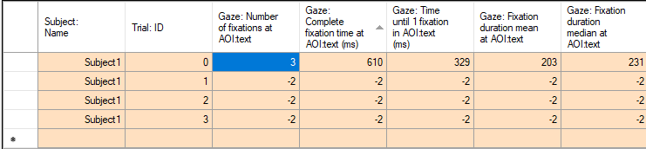
Analysis and design

Slide 24






Technical implementation (mastery of tools)

Slide 25
Open Sesame
Conduct Experiment
Collect Data
OGAMA
Conduct Experiment
Collect Data
IBM SPSS
Calculate ANOVA
Python
Filter and down-sample Data
Calculate PCA
Numpy, Pandas, (Tensorflow/Sklearn)

Slide 26

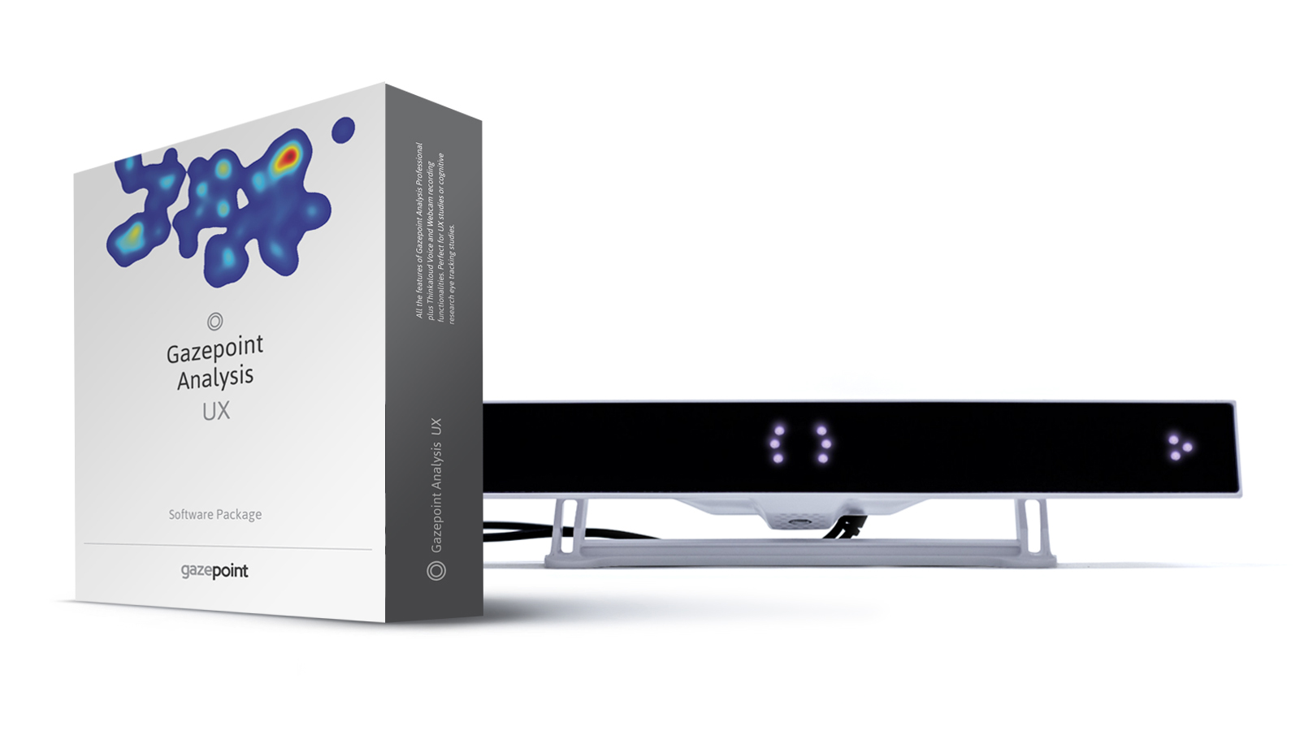


Slide 27

Stakeholders Collaboration Initiative
http://www.sdsassociates.com.my/
Notes:
Company doing research for other companies
Preliminary research (basic stuff)
Approach universities for more detailed and in-depth research

Slide 28
Benefit to us
Benefit for them
Provide us Tools and Technical Support
Conduct testing of tools and software
Perform detailed researches

Slide 29
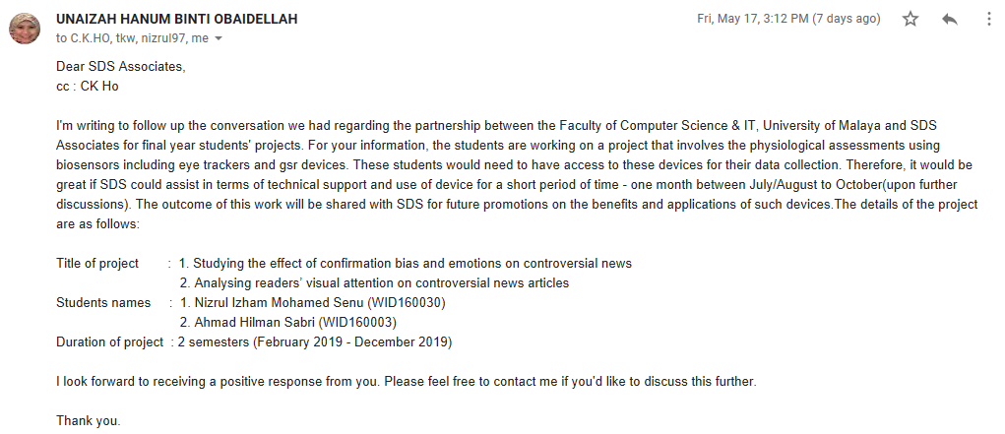

Slide 30
End of Slide

Slide 31
Methodology (4)
EXPERIMENT: In the introduction part, the participant will be given:
Introduction and Practice Trial
Pre-survey to detect existing confirmation bias.
Using Article A, the participant will:
Read the Article
Answer a post-survey to confirm confirmation bias on types of content.
After experiment for article A is complete, the participant will:
Be given a different task (Nizrul’s Experiment) as a distractor
Repeat the experiment using Article B.

